Slide 1

Sentinels
Hwa Chong Institution
Vincent Cayadi, Zhu Yunsong

Slide 2
Introduction
1/
Mechanical
2/
Electrical
3/
Table of contents
Programming
4/
Background information about our team
Hardware and design aspect of our robot
PCB Design and electronics
Program and algorithms of out robot

Slide 3
1/
Intro-
duction
The 2 man team from Hwa Chong Institution

Slide 4
2/
Mechanical
Mechanism and elements of our robot

Slide 5
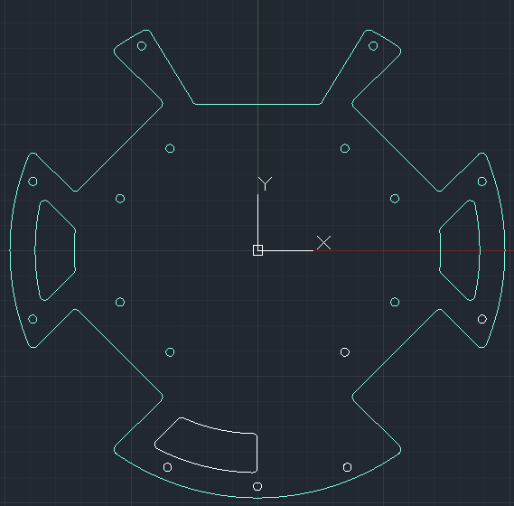
Layer 1
Motor
Slope

Slide 6
Omni-directional
45° Layout
Motor Layout
Wheels are 3D printed, with rubber rollers perpendicular to the wheel to make it omnidirectional
Such a layout allows the robot to move in all directions by controlling speed, power and direction of each individual wheel.

Slide 7
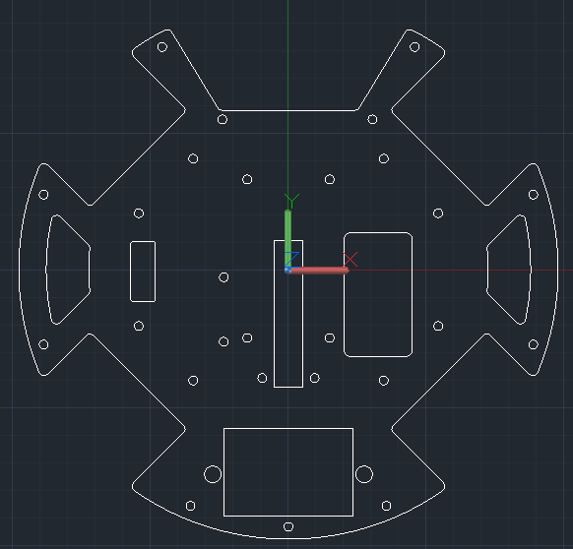
Layer 2
Dribbler with catchment area in front
Rec. hole on left for jumper cable
Rec. hole in center for kicker rack
Rec. hole on right for servo
Hole at the back for battery mount

Slide 8
Layer 3
Copy this slide
Houses our brains
Teensy 4.0 located here
IR Sensor placed here for the highest point of the ball
Camera is also located here
Have a 5 point connection to layer 2 so that the camera won't be shakey

Slide 9
Problems
Notes:
Taobao and Senior hogging the printers

Slide 10
3/
Electrical
Elec go boom

Slide 11
Schematic
Layer 1
Unchanged
Layer 2
GND Plane
Layer 3
Compass elec shoved there
Layer 4
Removed all the elec

Slide 12
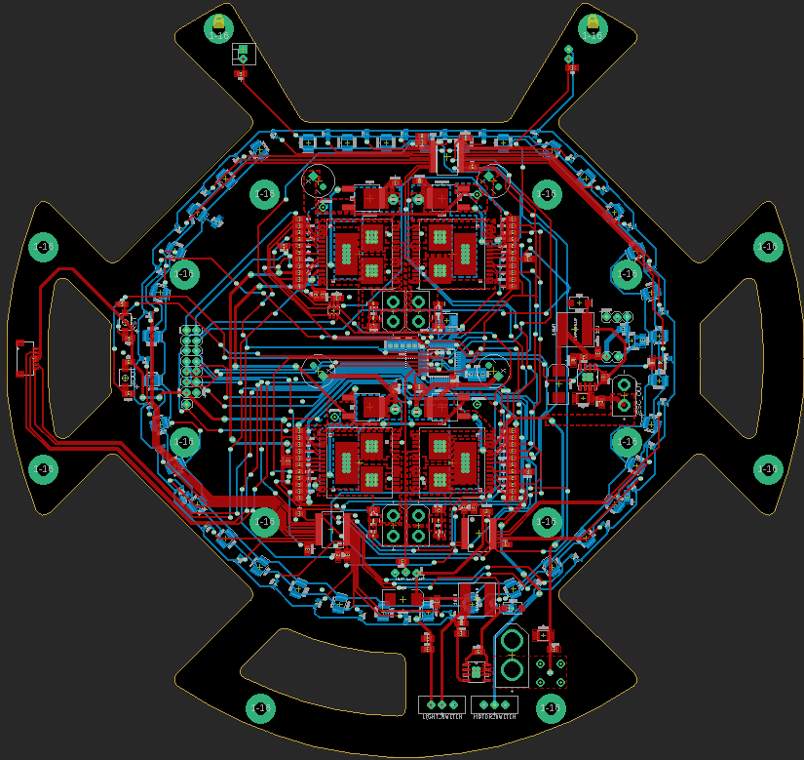
PCB : Layer 1
LED Ring
Motor Drivers
5V Step Down
3V Step Down

Slide 13
PCB : Layer 2
GND Plane
Block Off the Electromagnetic field of the Motor to shield the compass from the field

Slide 14
PCB : Layer 3
IR Sensors
OpenMV Camera
Compass Components

Slide 15
4/
Programming: Conceptual

Slide 16
Camera Localisation
Removed TOF so how?
<insert transcendence pic>

Slide 17
Closing Thoughts

Slide 18
Thanks!

Slide 19
Intro- duction
You can give a brief description of the topic you want to talk about here. For example, if you want to talk about Mercury, you can say that it’s the smallest planet in the entire Solar System

Slide 20
A little timeline
1950
2000
2010
2020
Mercury
Saturn
Venus
Neptune
It’s the closest planet to the Sun
It’s a gas giant with several rings
Venus is the second planet from the Sun
It’s the farthest planet from the Sun

Slide 21
Awesome words

Slide 22
The most common
Common passwords
Looking for the perfect password
Password | Security
Write your password here
Write your password here
Write your password here
Write your password here

Slide 23
Find the key
Saturn
Jupiter
Saturn is a gas giant with several rings
Jupiter is the biggest planet of them all
A perfect password
Mars
Neptune
Mars is actually a very cold place
It’s the farthest planet from the Sun

Slide 24

A picture is worth a thousand words

Slide 25
150,000
Big numbers catch your audience’s attention

Slide 26
Around the world
First place
Despite being red, Mars is actually a cold place. It’s full of iron oxide dust
Second place
Neptune is the farthest planet from the Sun. It’s very cold there

Slide 27
9h 55m 23s
333,000
386,000
Jupiter's rotation period
The Sun’s mass compared to Earth’s
Distance between Earth and the Moon

Slide 28
Data protection

Slide 29
Alternative resources
Photos
Top view of lock on keyboard
Top view of lock with key and password

Slide 30
Resources of this template
Icon pack
Icon Pack: Data Protection Lineal
Photos
Flat lay of hands holding notebook with password and laptop
Flat lay of laptop with hands and notebook with password information

